Slide 1

Maximizing the Spread of Influence through a Social
Network
By David Kempe, Jon Kleinberg, Eva Tardos
Report by Joe Abrams

Slide 2
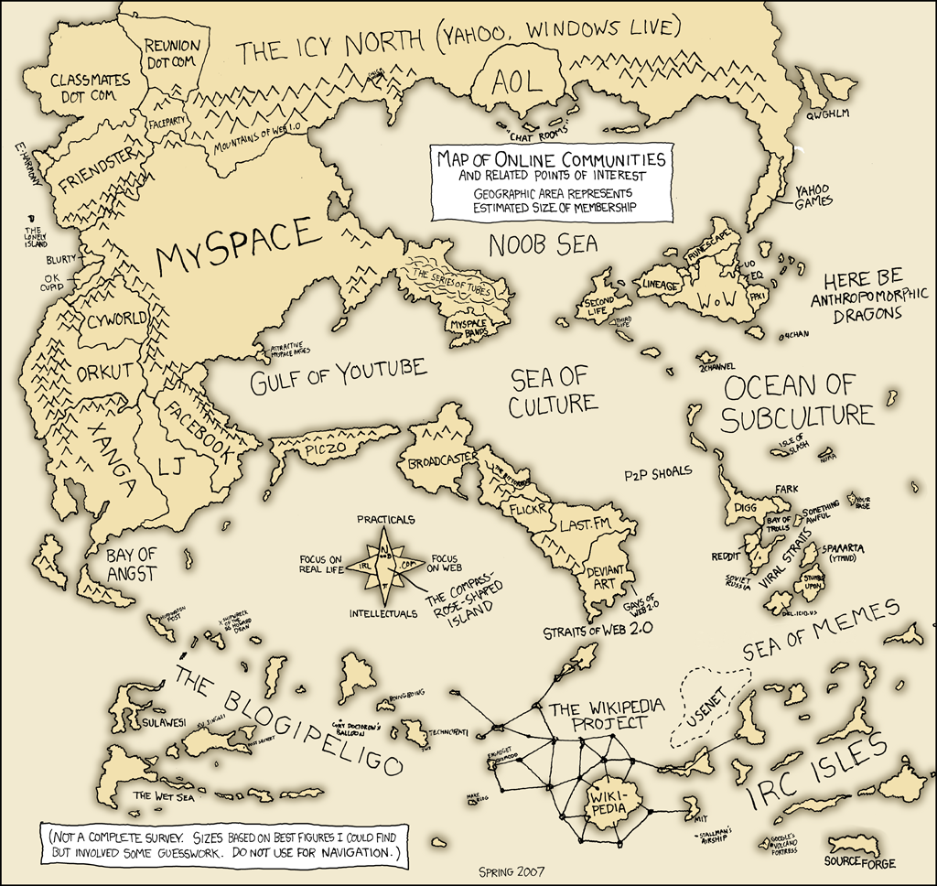
Social Networks

Slide 3
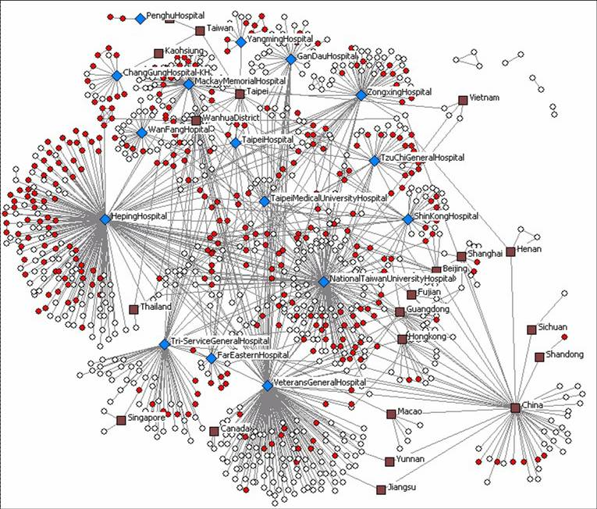
Infectious disease networks

Slide 4
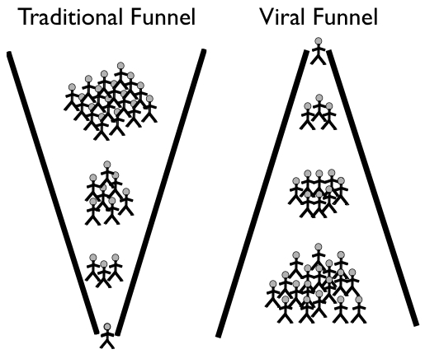
Viral Marketing

Slide 5
Viral Marketing
Example: Hotmail
Included service’s URL in every email sent by users
Grew from zero to 12 million users in 18 months with small advertising budget

Slide 6
Domingos and Richardson (2001, 2002)
Introduction to maximization of influence over social networks
Intrinsic Value vs. Network Value
Expected Lift in Profit (ELP)
Epinions, “web of trust”, 75,000 users and 500,000 edges

Slide 7
Domingos and Richardson (2001, 2002)
Viral marketing (using greedy hill-climbing strategy) worked very well compared with direct marketing
Robust (69% of total lift knowing only 5% of edges)

Slide 8
Diffusion Model: Linear Threshold Model
Each node (consumer) influenced by set of neighbors; has threshold Θ from uniform distribution [0,1]
When combined influence reaches threshold, node becomes “active”
Active node now can influence its neighbors
Weighted edges

Slide 9
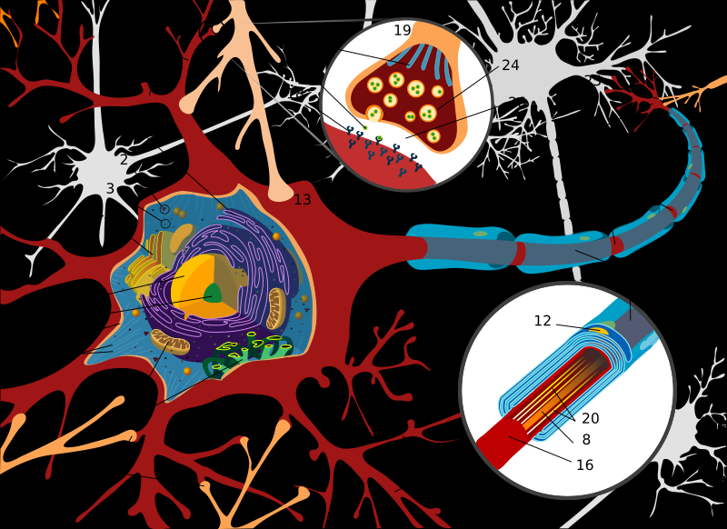
Diffusion Model: Linear Threshold Model

Slide 10
Diffusion Model: Independent Cascade Model
Each active node has a probability p of activating a neighbor
At time t+1, all newly activated nodes try to activate their neighbors
Only one attempt for per node on target
Akin to turn-based strategy game?

Slide 11
Influence Maximization
Using greedy hill-climbing strategy, can approximate optimum to within a factor of (1 – 1/e – ε), or ~63%
Proven using theories of submodular functions (diminishing returns)
Applies to both diffusion models

Slide 12
Testing on network data
Co-authorship network
High-energy physics theory section of www.arxiv.org
10,748 nodes (authors) and ~53,000 edges
Multiple co-authored papers listed as parallel edges (greater weight)

Slide 13
Testing on network data
Linear Threshold: influence weighed by # of parallel lines, inversely weighed by degree of target node: w = c_{u,v} /d_{v}
Independent Cascade: p set at 1% and 10%; total probability for u v is
1 – (1 – p)^c_{u,v}
Weighted Cascade: p = 1/ d_{v}

Slide 14
Algorithms
Greedy hill-climbing
High degree: nodes with greatest number of edges
Distance centrality: lowest average distance with other nodes
Random

Slide 15
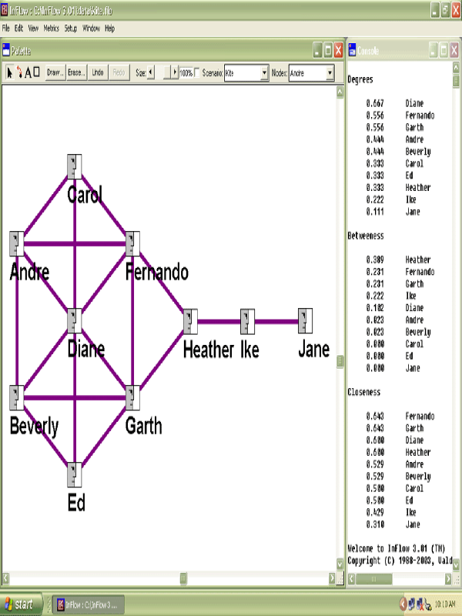
Algorithms

Slide 16
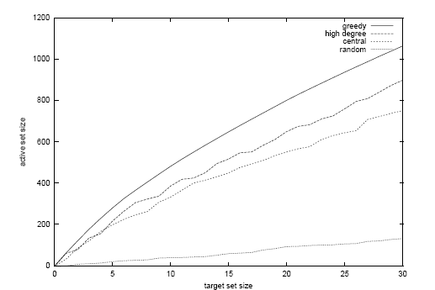
Results: Linear Threshold Model
Greedy: ~40% better than central, ~18% better than high degree

Slide 17
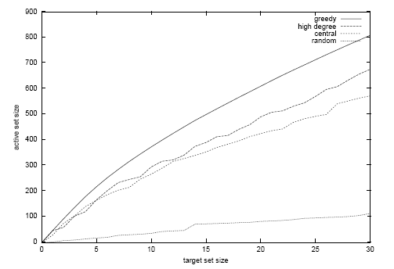
Results: Weighted Cascade Model

Slide 18
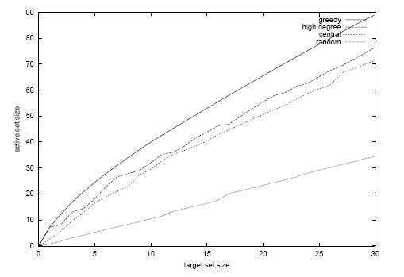
Results: Independent Cascade, p = 1%

Slide 19
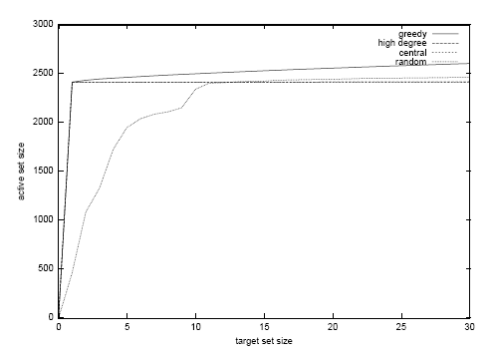
Results: Independent Cascade, p = 10%

Slide 20
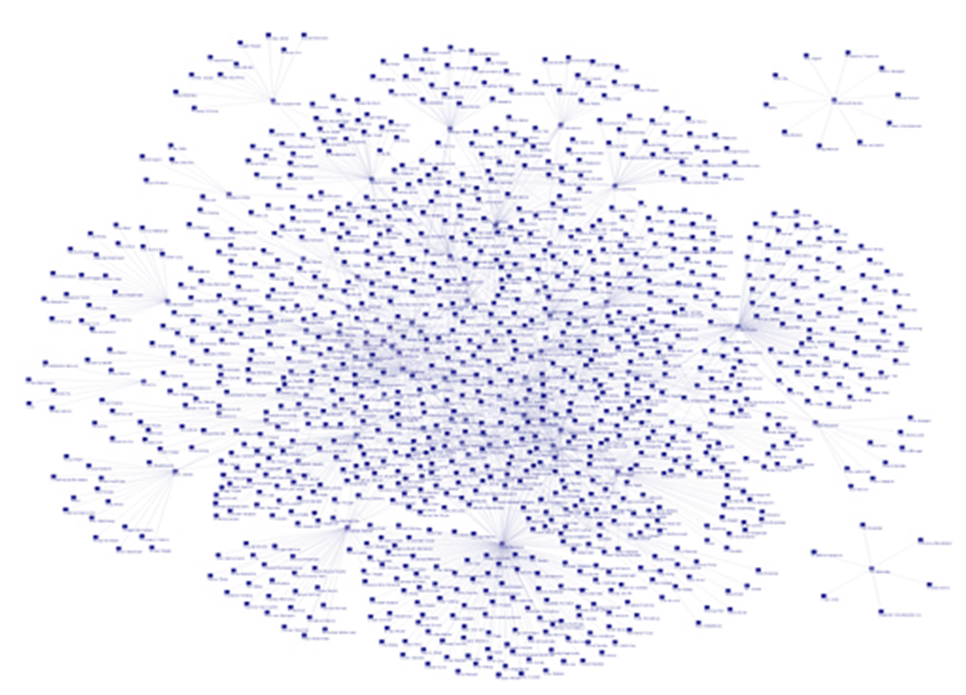
Advantages of Random Selection

Slide 21
Generalized models
Generalized Linear Threshold: for node v, influence of neighbors not necessarily sum of individual influences
Generalized Independent Cascade: for node v, probability p depends on set of v’s neighbors that have previously tried to activate v
Models computationally equivalent, impossible to guarantee approximation

Slide 22
Non-Progressive Threshold Model
Active nodes can become inactive
Similar concept: at each time t, whether or not v becomes/stays active depends on if influence meets threshold
Can “intervene” at different times; need not perform all interventions at t = 0
Answer to progressive model with graph G equivalent to non-progressive model with layered graph G^{τ}

Slide 23
General Marketing Strategies
Can divide up total budget κ into equal increments of size δ
For greedy hill-climbing strategy, can guarantee performance within factor of
1 – e^[-(κ *γ)/(κ + δ *n)]
As δ decreases relative to κ, result approaches 1 – e⁻¹ = 63%

Slide 24
Strengths of paper
Showed results in two complementary fashions: theoretical models and test results using real dataset
Demonstrated that greedy hill-climbing strategy could guarantee results within 63% of optimum
Used specific and generalized versions of two different diffusion models

Slide 25
Weaknesses of paper
Doesn’t fully explain methodology of greedy hill-climbing strategy
Lots of work not shown – simply refers to work done in other papers
Threshold value uniformly distributed?
Influence inversely weighted by degree of target?

Slide 26

Questions?

